Slide 1
RUSTikales Rust for advanced coders

Slide 2
Plan for today

Slide 3
Plan for today
Recap

Slide 4
Plan for today
Recap
syn + quote

Slide 5
Recap

Slide 6
Recap
Rust has two very powerful macro systems

Slide 7
Recap
Rust has two very powerful macro systems
Macros are useful for metaprogramming

Slide 8
Recap
Rust has two very powerful macro systems
Macros are useful for metaprogramming
Declarative Macros are declared using the keyword macro_rules!

Slide 9
Recap
Rust has two very powerful macro systems
Macros are useful for metaprogramming
Declarative Macros are declared using the keyword macro_rules!
Procedural Macros are special crates
proc-macro is a type of library

Slide 10
Recap
Rust has two very powerful macro systems
Macros are useful for metaprogramming
Declarative Macros are declared using the keyword macro_rules!
Procedural Macros are special crates
Procedural Macros allow us to write powerful macros in normal Rust

Slide 11
Recap
Rust has two very powerful macro systems
Macros are useful for metaprogramming
Declarative Macros are declared using the keyword macro_rules!
Procedural Macros are special crates
Procedural Macros allow us to write powerful macros in normal Rust
There are three types of procedural macros
proc_macro → Function-like macros
proc_macro_derive → Derive macros
proc_macro_attribute → Attribute macros

Slide 12
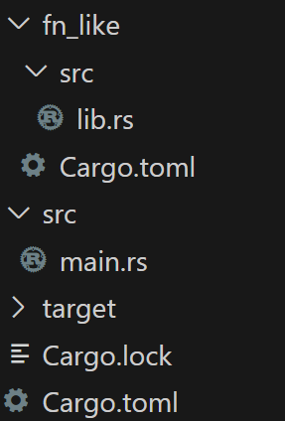
Recap

Slide 13
Recap
Idea:
→ fn_like is a proc-macro crate

Slide 14
Recap
Idea:
→ fn_like is a proc-macro crate → In there, we define a macro which we want to use

Slide 15
Recap
Idea:
→ fn_like is a proc-macro crate → In there, we define a macro which we want to use → We later use that macro in our main application

Slide 16
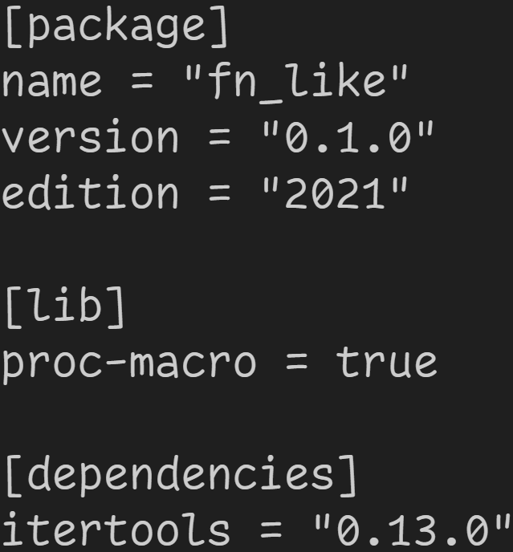
Recap
We are here
Mark crate as proc-macro

Slide 17
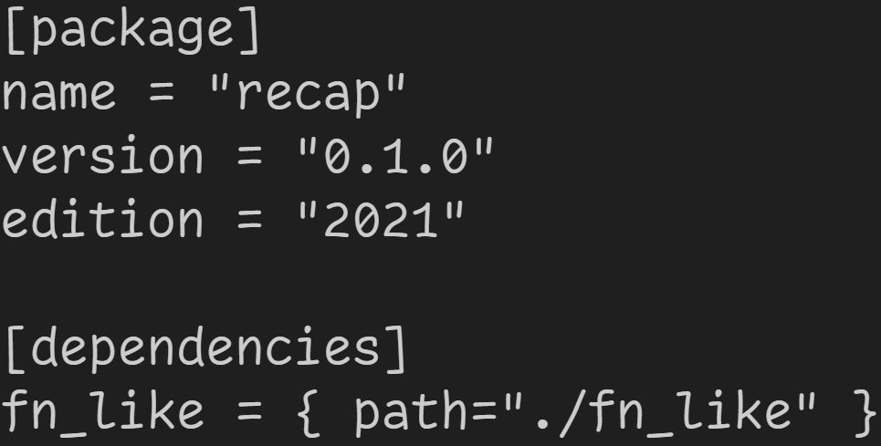
Recap
We are here
use proc-macro in our main application

Slide 18
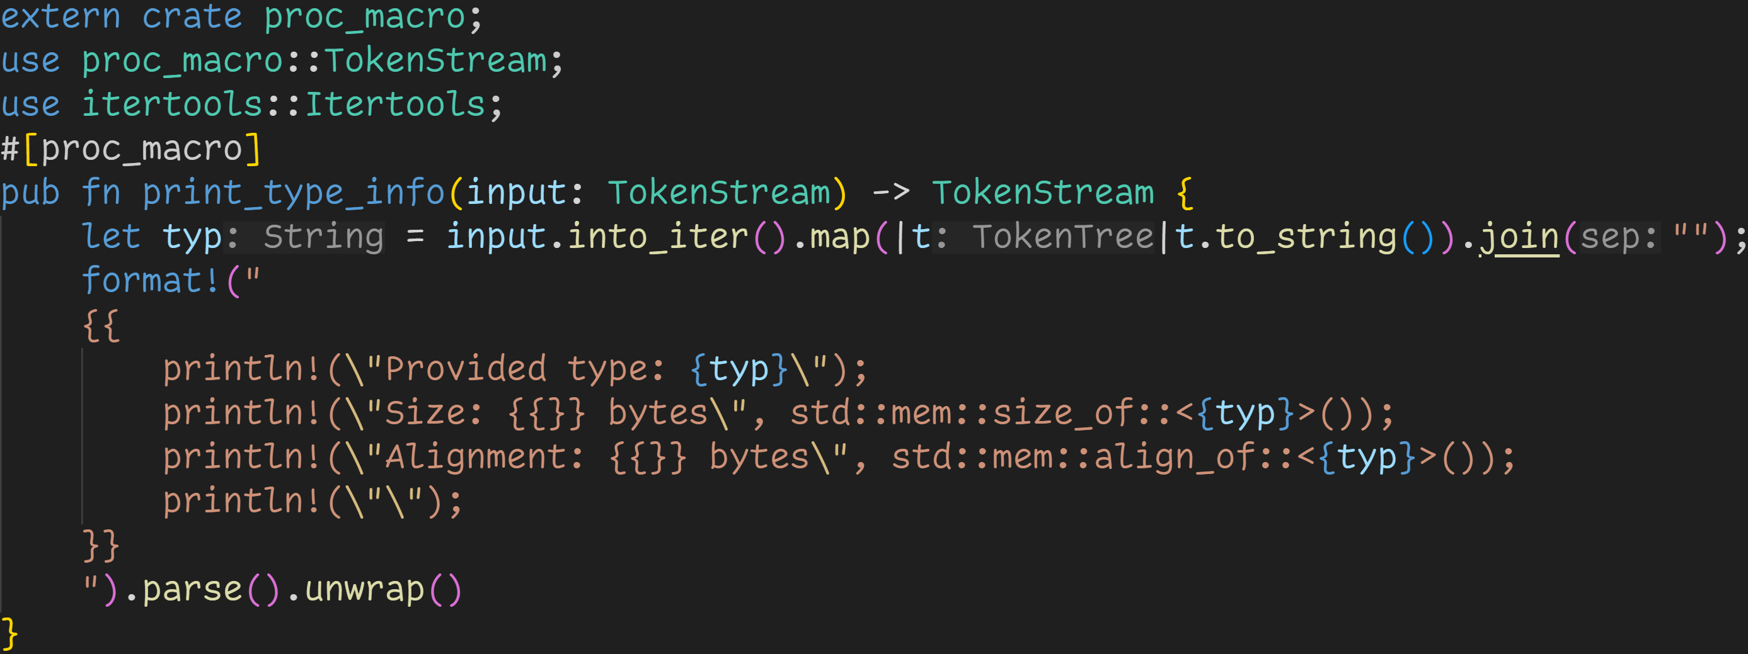
Recap
We are here

Slide 19
Recap
The attribute defines the macro type
Here: We declare a Function-like macro
We are here

Slide 20
Recap
Procedural macros work on a TokenStream instead of matching rules like macro_rules!
We are here

Slide 21
Recap
We are here
Procedural macros are normal functions which are called at compile time
→ Plugins for the compiler

Slide 22
Recap
Procedural macros are written in normal Rust
→ You can also import other crates!
We are here

Slide 23
Recap
We are here
Take all input tokens, and turn them into a single string
& + str → &str

Slide 24
Recap
The macro can‘t check if the generated String is a valid type.
It only generates code.
The Type Checker will have to figure that out.
We are here

Slide 25
Recap
We are here
Generate code!
Here: Print (at runtime) some information about the provided type

Slide 26
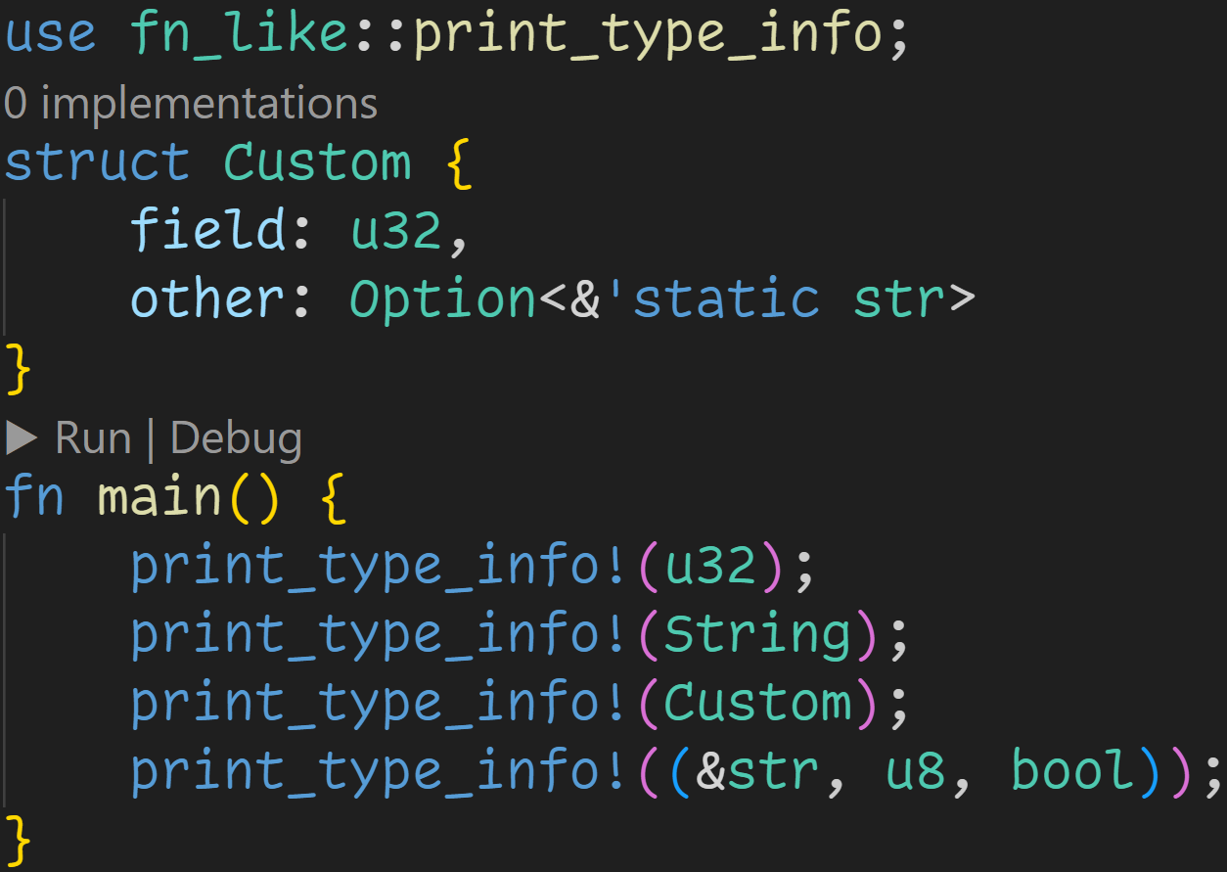
Recap
proc-macros are used like any other crate
We are here

Slide 27
Recap
At compile time, we call this macro four times and generate new code at those locations
We are here

Slide 28
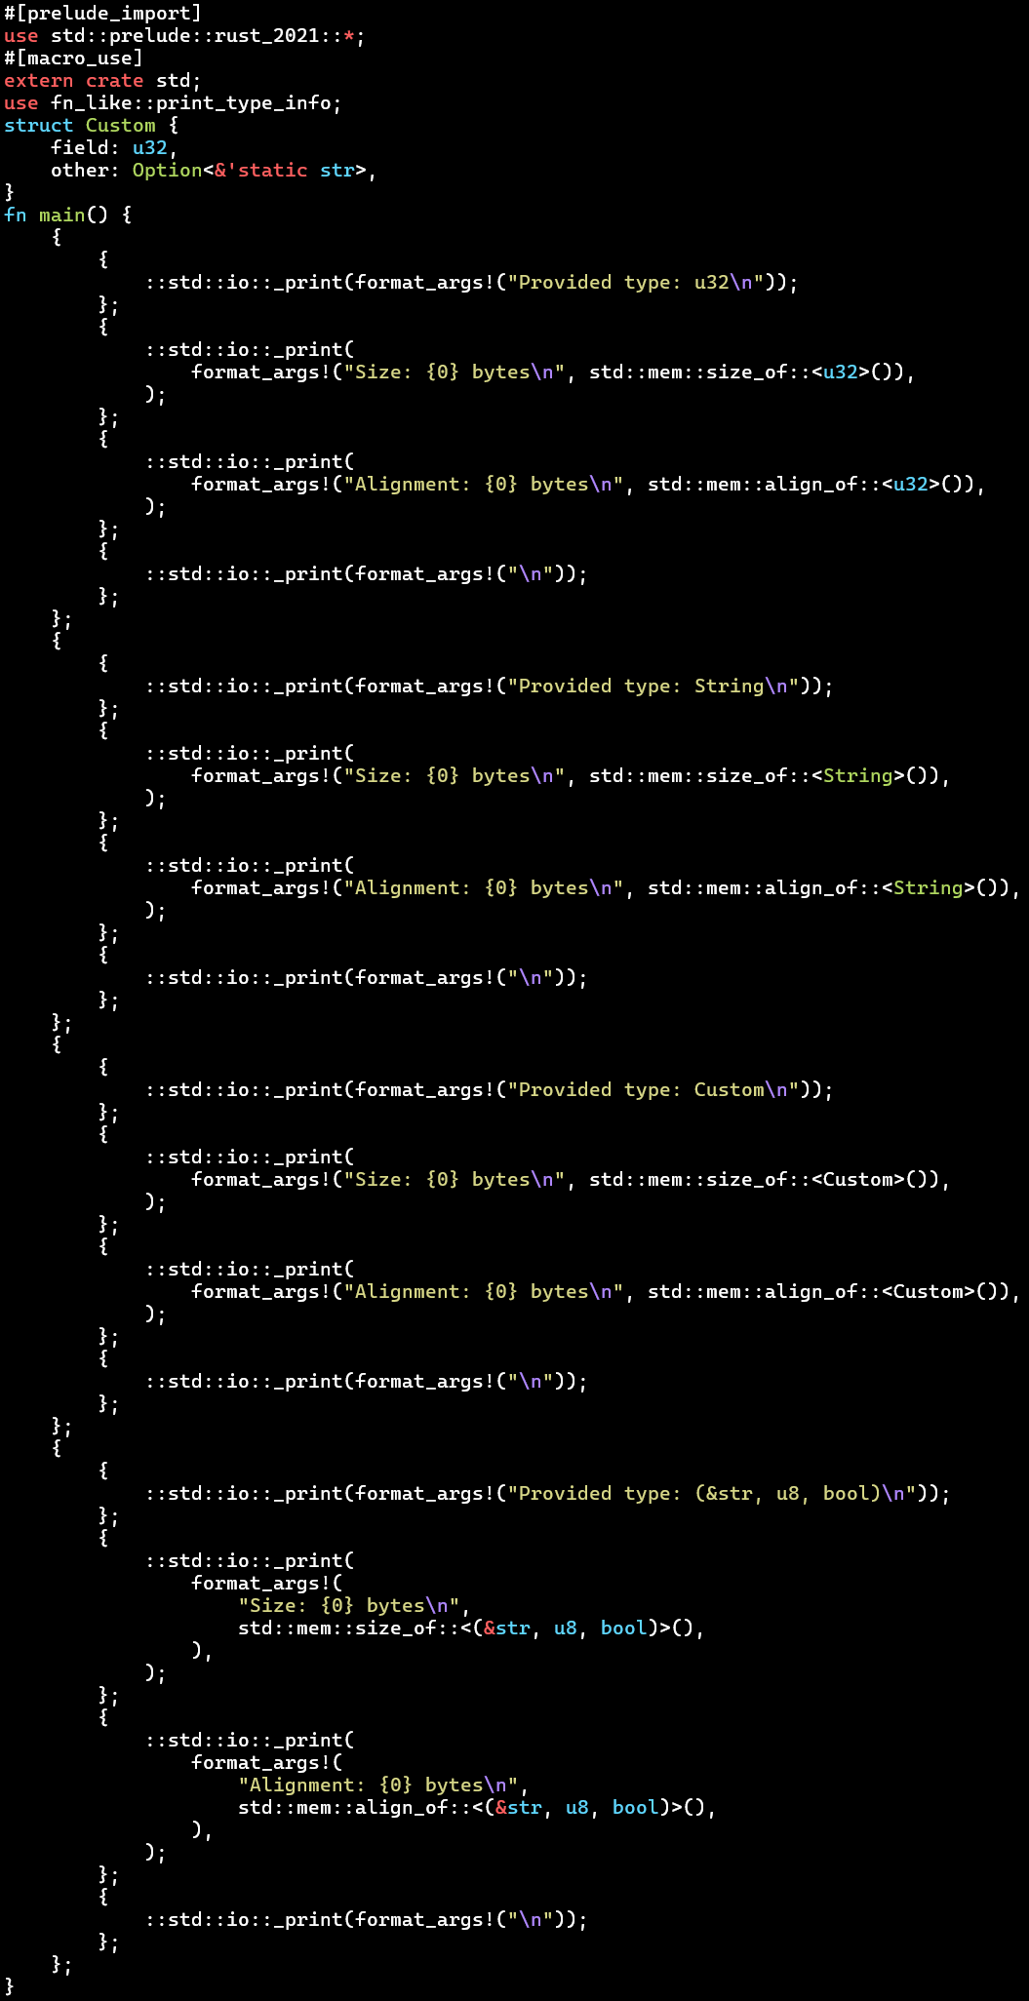
Recap
cargo expand

Slide 29
Recap
cargo expand
Macros can easily generate a lot of code, which can result in worse compile times
→ Use macros responsibly

Slide 30
Recap
cargo expand
Macros can easily generate a lot of code, which can result in worse compile times
→ Use macros responsibly
When trying to de-duplicate code, this order is recommended:
Functions → Generics + Traits → Macros

Slide 31
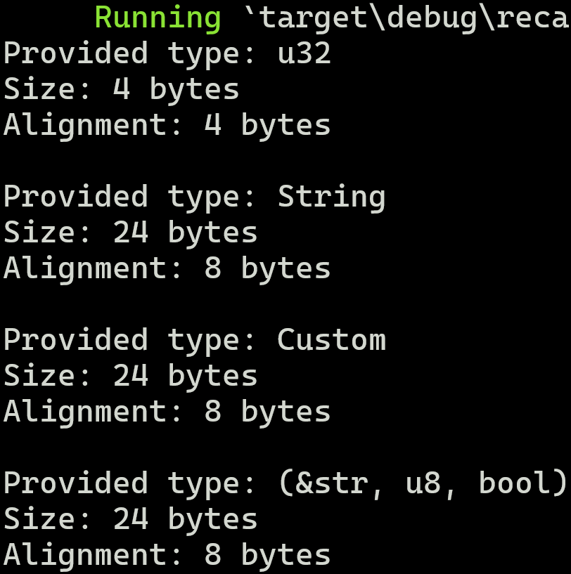
Recap
cargo run

Slide 32
syn + quote

Slide 33
syn + quote
As we‘ve seen last time, proc-macros are really difficult to manage properly

Slide 34
syn + quote
As we‘ve seen last time, proc-macros are really difficult to manage properly
You can use proc-macros at many different locations, with different inputs, and generate anything you want

Slide 35
syn + quote
As we‘ve seen last time, proc-macros are really difficult to manage properly
You can use proc-macros at many different locations, with different inputs, and generate anything you want
At the same time, the compiler doesn‘t offer much utility except a stream of tokens

Slide 36
syn + quote
As we‘ve seen last time, proc-macros are really difficult to manage properly
You can use proc-macros at many different locations, with different inputs, and generate anything you want
At the same time, the compiler doesn‘t offer much utility except a stream of tokens
But thanks to contributors all around the world, we don‘t need to suffer

Slide 37
syn + quote
As we‘ve seen last time, proc-macros are really difficult to manage properly
You can use proc-macros at many different locations, with different inputs, and generate anything you want
At the same time, the compiler doesn‘t offer much utility except a stream of tokens
But thanks to contributors all around the world, we don‘t need to suffer
To showcase the power of third-party libraries, we will do two things today
We will implement a Derive macro that also works on types with generic types and lifetime parameters
We will implement an Attribute macro that replaces identifiers

Slide 38
syn + quote
syn is a very useful crate for developing procedural macros
It‘s so useful, at some point you just have to use it

Slide 39
syn + quote
syn is a very useful crate for developing procedural macros
syn allows us to parse TokenStreams into data structures, which are more convenient to use

Slide 40
syn + quote
syn is a very useful crate for developing procedural macros
syn allows us to parse TokenStreams into data structures, which are more convenient to use
Additionally, syn offers some useful macros and traits to make development even easier

Slide 41
syn + quote
syn is a very useful crate for developing procedural macros
syn allows us to parse TokenStreams into data structures, which are more convenient to use
Additionally, syn offers some useful macros and traits to make development even easier
syn offers two main ways of working with its Parser
By using the parse_macro_input!() macro
By using the Parse trait

Slide 42
syn + quote
quote is another useful crate for developing procedural macros
It‘s so convenient, at some point you just have to use it

Slide 43
syn + quote
quote is another useful crate for developing procedural macros
quote has a macro quote! which performs quasi-quoting

Slide 44
syn + quote
quote is another useful crate for developing procedural macros
quote has a macro quote! which performs quasi-quoting
Quasi-quoting means writing code that looks like code to our IDE, but treating it as data

Slide 45
syn + quote
quote is another useful crate for developing procedural macros
quote has a macro quote! which performs quasi-quoting
Quasi-quoting means writing code that looks like code to our IDE, but treating it as data
With quote! we no longer have to format String literals, but instead write normal code

Slide 46
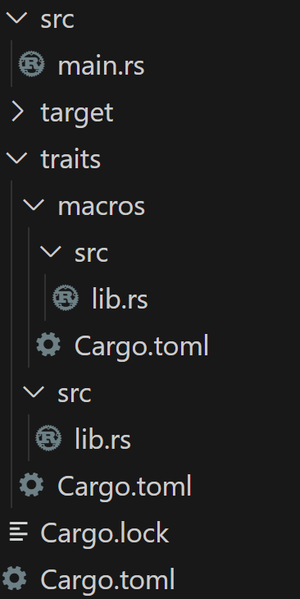
syn + quote

Slide 47
syn + quote
Idea:
→ traits is a normal library crate

Slide 48
syn + quote
Idea:
→ traits is a normal library crate → In there, we define a trait which we want to derive

Slide 49
syn + quote
Idea:
→ traits is a normal library crate → In there, we define a trait which we want to derive → The proc-macro is implemented inside that crate

Slide 50
syn + quote
Idea:
→ traits is a normal library crate → In there, we define a trait which we want to derive → The proc-macro is implemented inside that crate
→ We later derive the trait in our main application

Slide 51
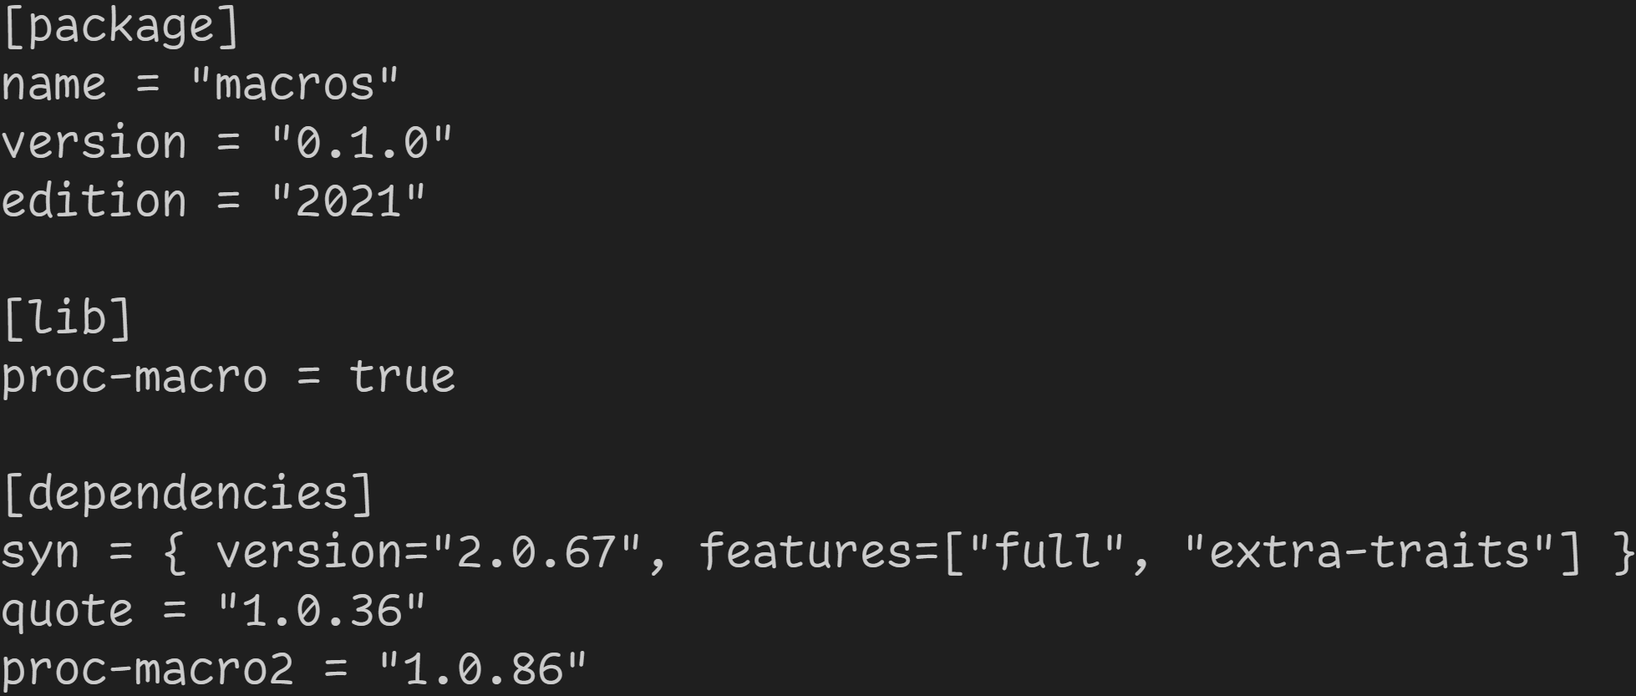
syn + quote
Mark crate as proc-macro
We are here

Slide 52
syn + quote
syn and quote can be imported like any other crate, additionally we will also need some extra features
We are here

Slide 53
syn + quote
syn and quote can be imported like any other crate, additionally we will also need some extra features
proc-macro2 is needed because syn and quote prefer those types over the normal proc-macro types
We are here

Slide 54
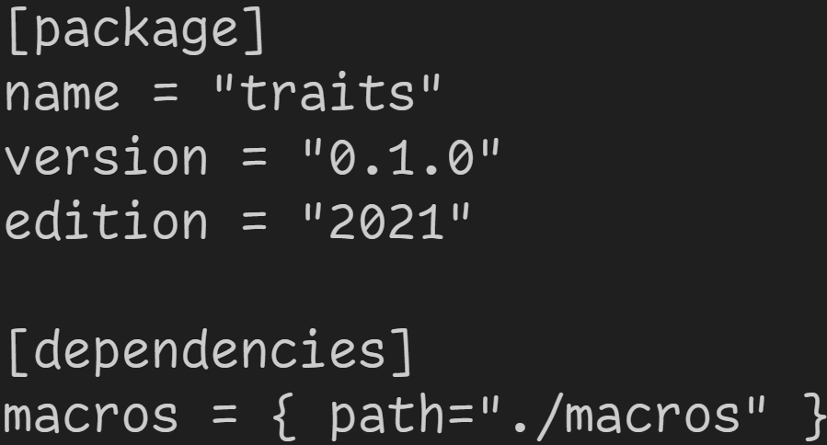
syn + quote
We are here
use proc-macro in our library

Slide 55
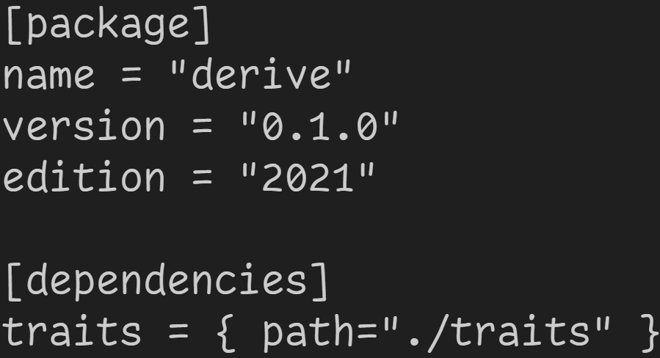
syn + quote
use our library in our main application
We are here

Slide 56
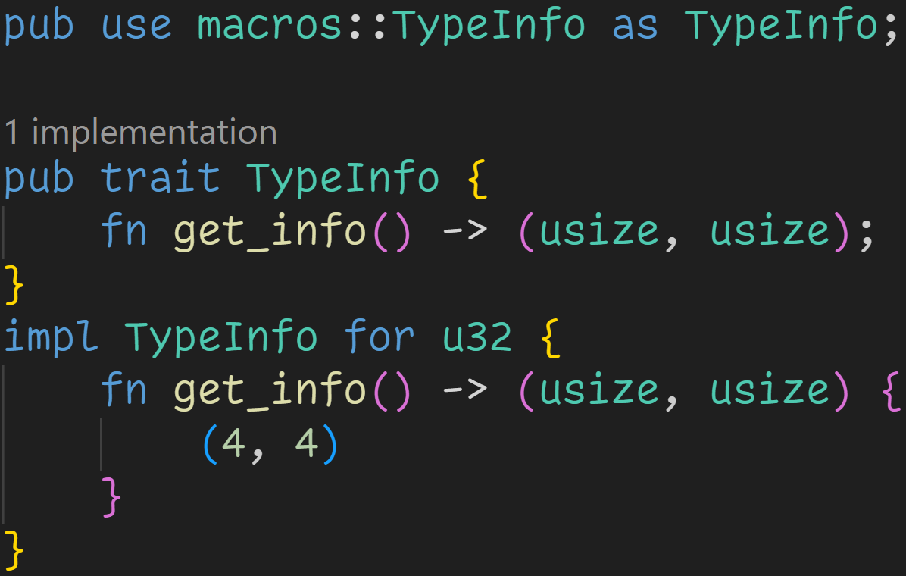
syn + quote
We are here

Slide 57
syn + quote
Simple re-export so we can write use traits::TypeInfo instead of use traits::macros::TypeInfo
We are here

Slide 58
syn + quote
The trait we want to derive, does the same as the macro in the recap, but returns the values instead of printing them
We are here

Slide 59
syn + quote
We are here
Implementing the trait for all types is tiring, we need derive :^)

Slide 60
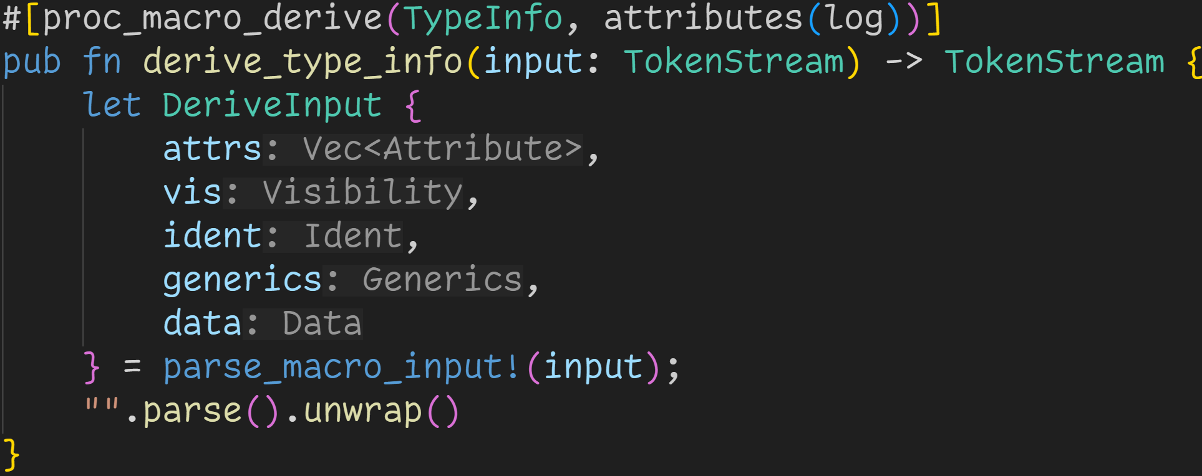
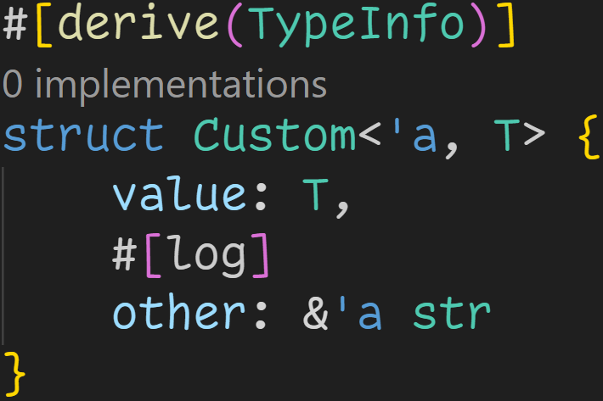
syn + quote
We are here

Slide 61
syn + quote
Specify name which we later need to provide
We are here

Slide 62
syn + quote
We are here
We can also provide extra attributes in derive macros
Here: When the trait method is called, print Logging field <name> for every tagged field

Slide 63
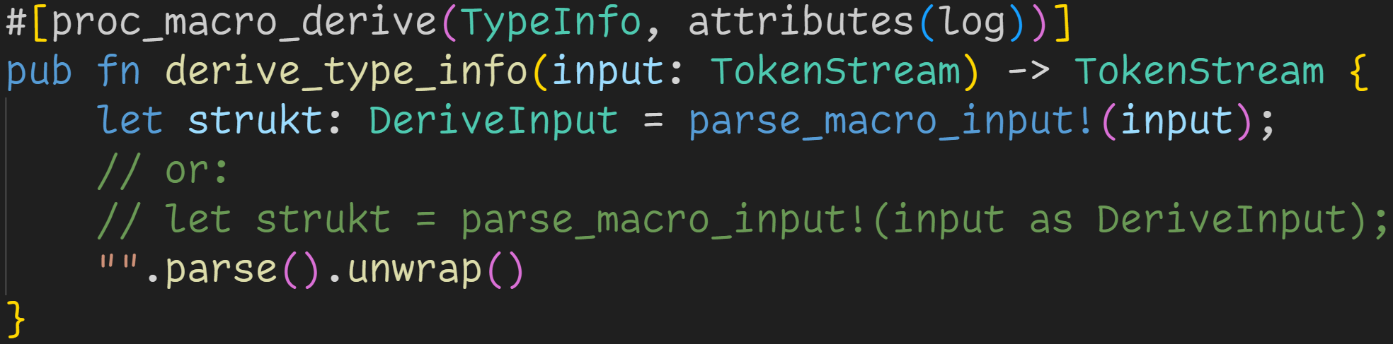
syn + quote
We are here

Slide 64
syn + quote
parse_macro_input!() tries to parse the desired construct, and triggers a compiler error if it fails
We are here

Slide 65
syn + quote
We are here
The desired output can be provided via two means:
→ Specify variable type → Use pseudo-typecast

Slide 66
syn + quote
Downside of parse_macro_input!():
You can only use it in functions that return a TokenStream
We are here

Slide 67
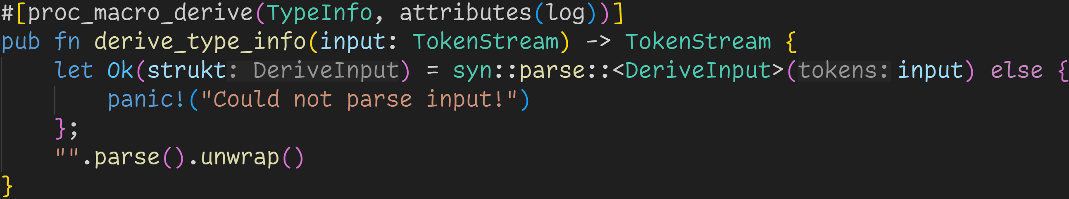
syn + quote
We are here
You can also use the Parser directly, if you want to
Benefit: You have more control, and you can even implement the Parse-trait for your own structs

Slide 68
syn + quote
syn allows us to easily parse the input into any form we want, so we can easily work with it
DeriveInput includes:
We are here

Slide 69
syn + quote
syn allows us to easily parse the input into any form we want, so we can easily work with it
DeriveInput includes:
→ Attributes that came after the derive call
We are here

Slide 70
syn + quote
syn allows us to easily parse the input into any form we want, so we can easily work with it
DeriveInput includes:
→ Attributes that came after the derive call → Visibility (public, private)
We are here

Slide 71
syn + quote
syn allows us to easily parse the input into any form we want, so we can easily work with it
DeriveInput includes:
→ Attributes that came after the derive call → Visibility (public, private)
→ Name of the input (here: struct name)
We are here

Slide 72
syn + quote
syn allows us to easily parse the input into any form we want, so we can easily work with it
DeriveInput includes:
→ Attributes that came after the derive call → Visibility (public, private)
→ Name of the input (here: struct name) → Generic types and lifetime parameters
We are here

Slide 73
syn + quote
syn allows us to easily parse the input into any form we want, so we can easily work with it
DeriveInput includes:
→ Attributes that came after the derive call → Visibility (public, private)
→ Name of the input (here: struct name) → Generic types and lifetime parameters → Enum of: Struct Fields, Enum Variants, Union Fields
We are here

Slide 74
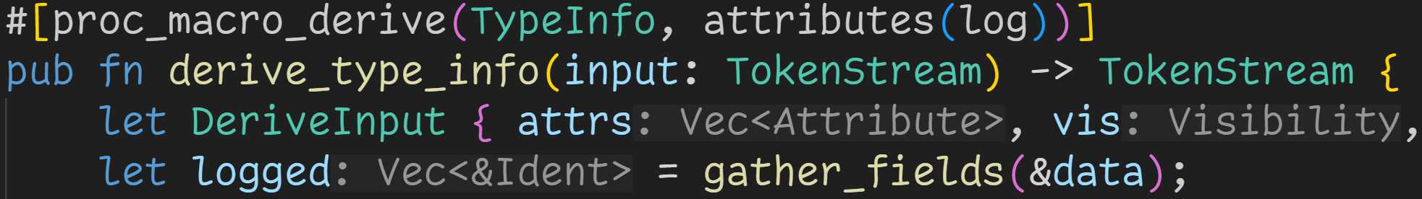
syn + quote
We are here
We can now easily work with that data

Slide 75
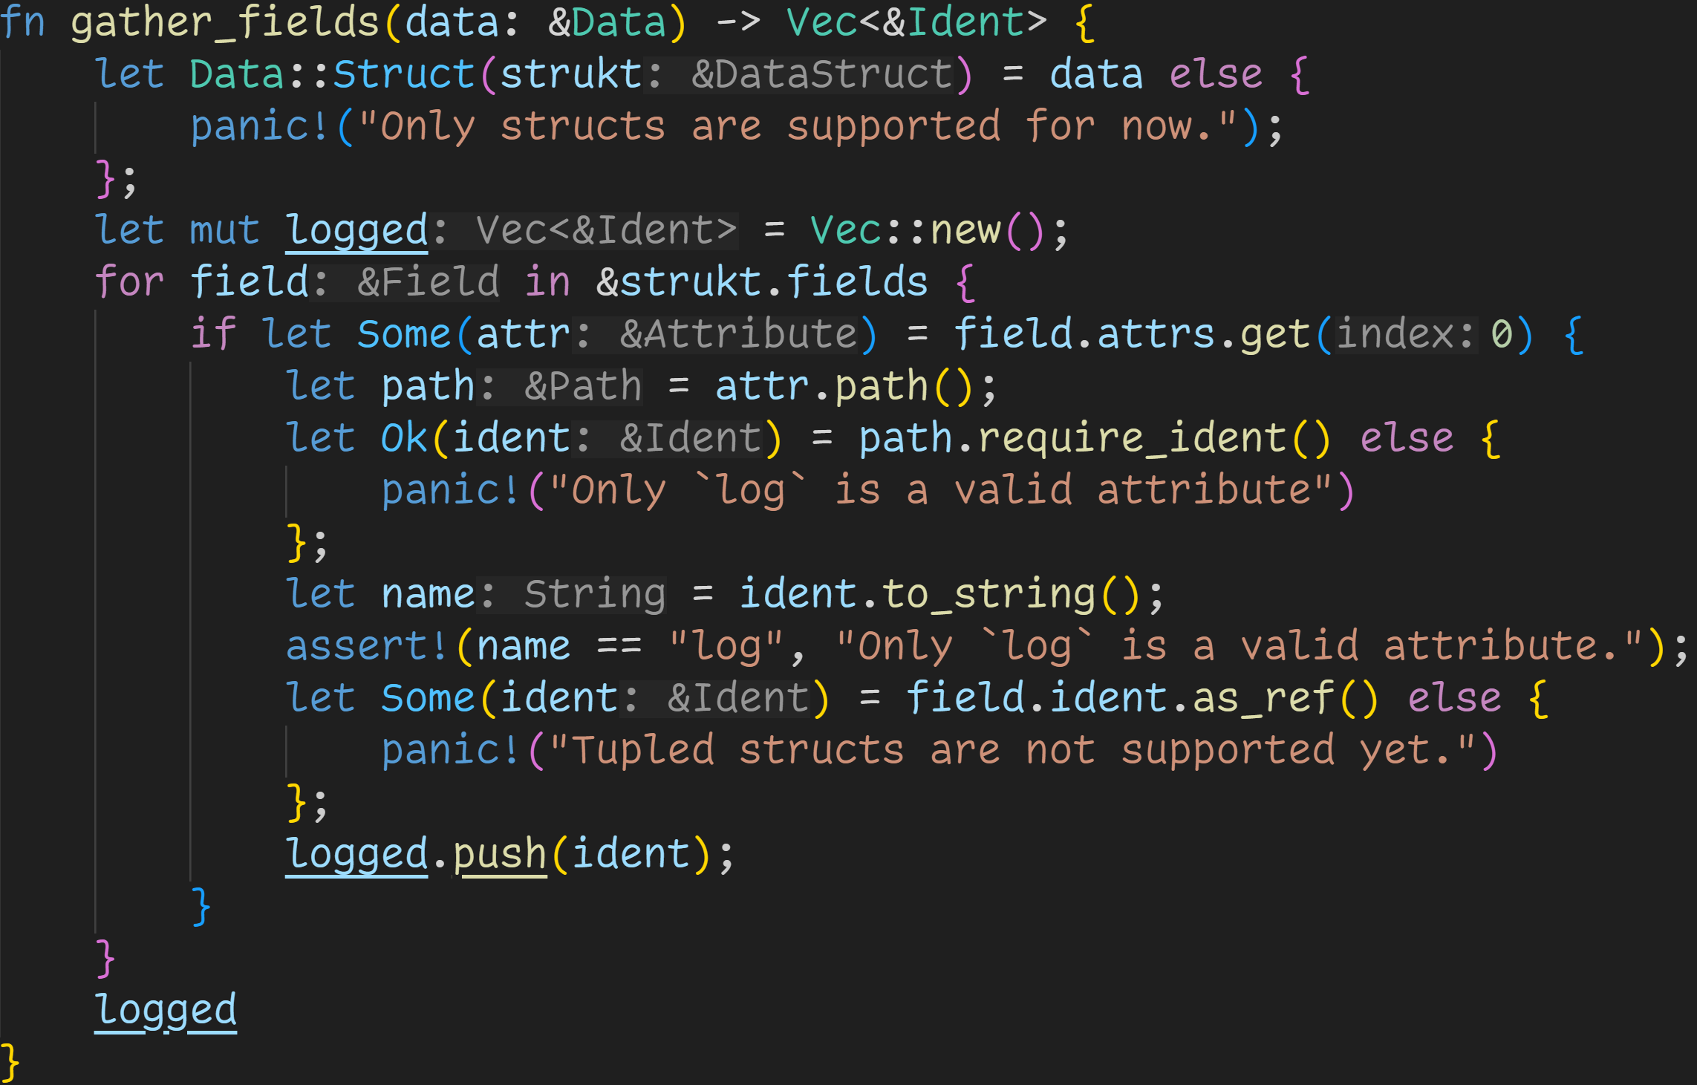
syn + quote
We are here
Using real data structures instead of token streams now makes the whole thing a breeze

Slide 76
syn + quote
Expect a struct
We are here

Slide 77
syn + quote
We are here
Iterate over all fields

Slide 78
syn + quote
We are here
If the field has an attribute, check if it is the one we want

Slide 79
syn + quote
We are here
A Path is a sequence of identifiers, like traits::macros::TypeInfo or path

Slide 80
syn + quote
We are here
Make sure it‘s the correct attribute

Slide 81
syn + quote
We are here
Add field name to list of fields that need to be logged

Slide 82
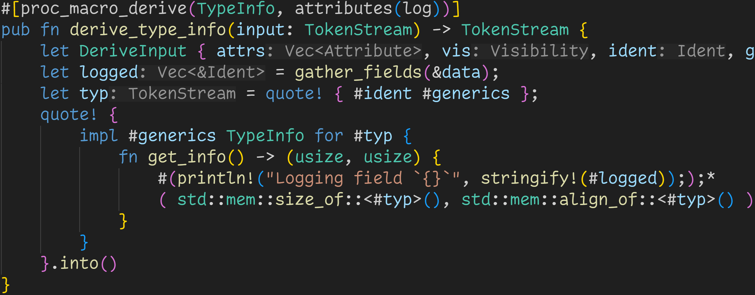
syn + quote
We are here
logged now contains all field names which were tagged with #[log]

Slide 83
syn + quote
We are here
Now we can focus on this macro
→ As we can see, this macro is a bit more advanced than formatting Strings :^)

Slide 84
syn + quote
We are here
Quasi-quoting means the code is the data
→ We write code, the IDE can highlight it, but the macro operates on it

Slide 85
syn + quote
We are here
quote! is a declarative macro that takes the provided input and turns it into a TokenStream

Slide 86
syn + quote
We are here
quote! is a declarative macro that takes the provided input and turns it into a TokenStream
→ Every normal token is simply passed along

Slide 87
syn + quote
We are here
quote! is a declarative macro that takes the provided input and turns it into a TokenStream
→ Every normal token is simply passed along → quote! interpolates #, inserting the specific value of a variable into the Stream

Slide 88
syn + quote
We are here
quote! is a declarative macro that takes the provided input and turns it into a TokenStream
→ Every normal token is simply passed along → quote! interpolates #, inserting the specific value of a variable into the Stream → typ is a token concatenation of the name plus any generics the struct may have

Slide 89
syn + quote
We are here
quote! also allows repetition, for example when we want to generate code for every element in a collection → Here: Emit one println! for every logged field

Slide 90
syn + quote
We are here
→ quote! returns proc_macro2::TokenStream
→ Procedural macros require proc_macro::TokenStream → We need to convert the stream first before returning :^)

Slide 91
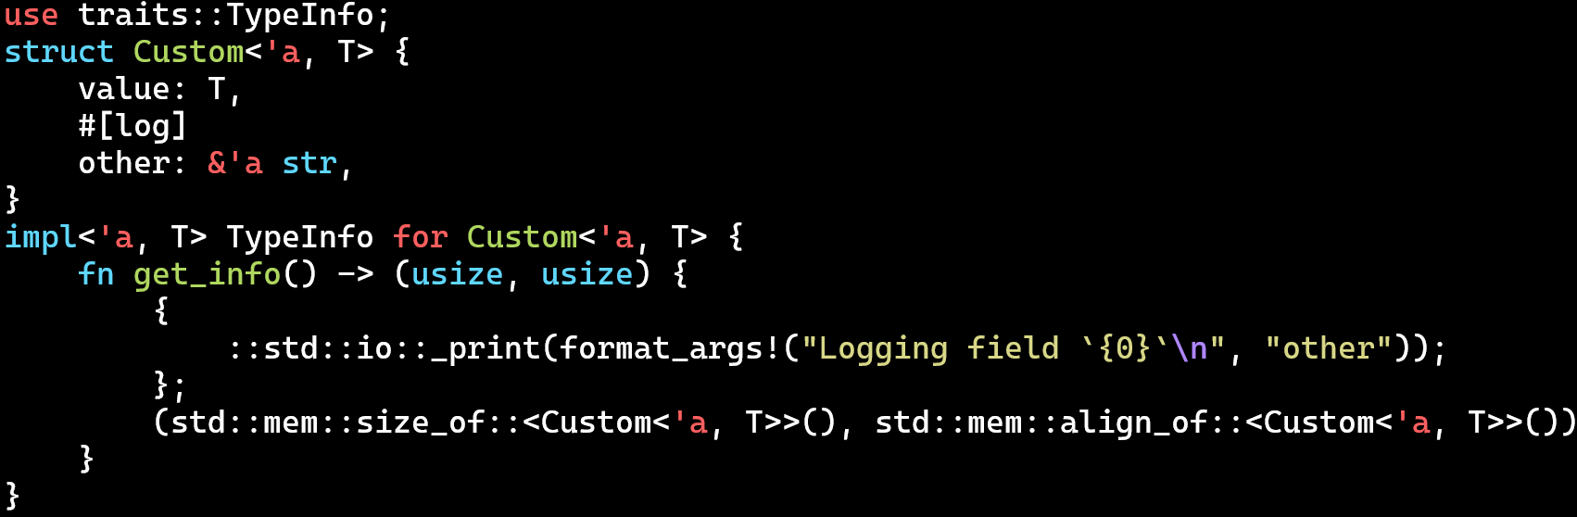
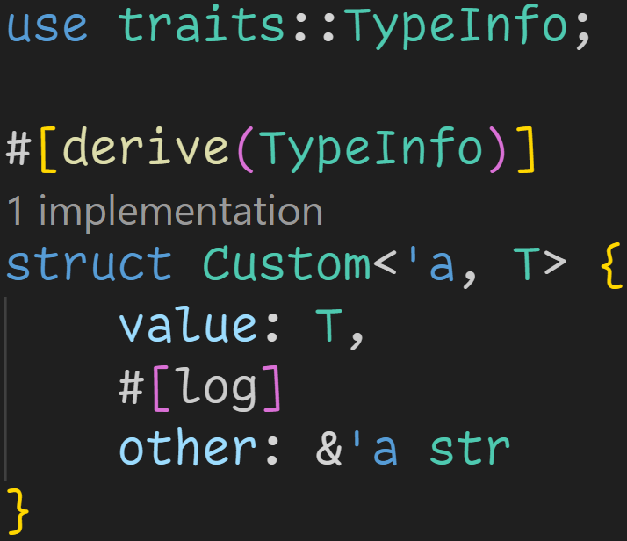
syn + quote
cargo expand

Slide 92
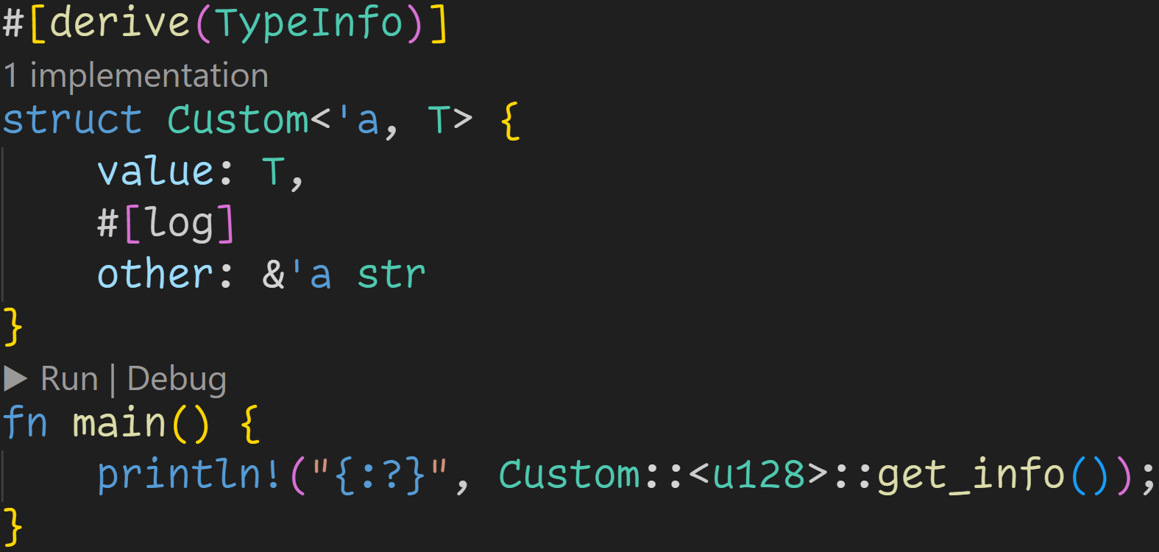
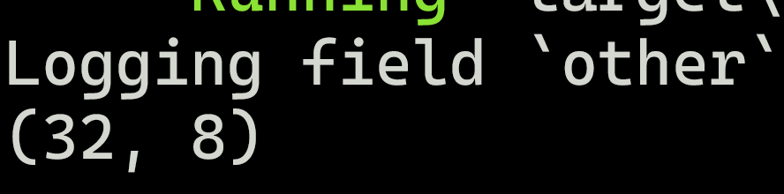
syn + quote
cargo run

Slide 93
syn + quote
For the Attribute macro, we will go for two things

Slide 94
syn + quote
For the Attribute macro, we will go for two things
An attribute that allows us to replace identifiers in functions
An attribute that hijacks string literals, and replaces them with a different text

Slide 95
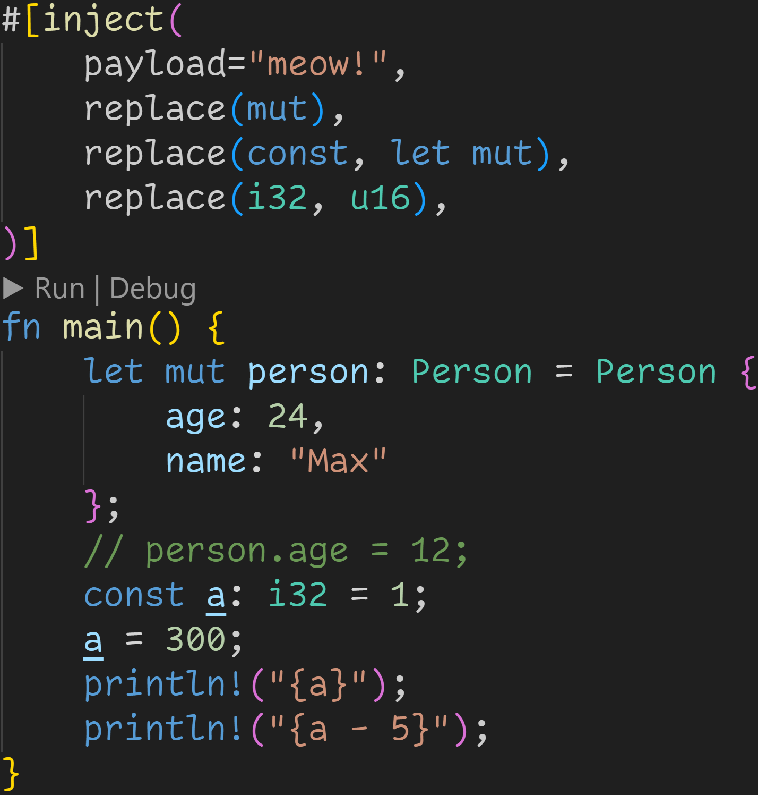
syn + quote

Slide 96
syn + quote
The macro invocation

Slide 97
syn + quote
Replace every string literal inside the function with the given string

Slide 98
syn + quote
Replace the identifier on the left side with the sequence on the right side

Slide 99
syn + quote
Yes, this code will compile :^)

Slide 100
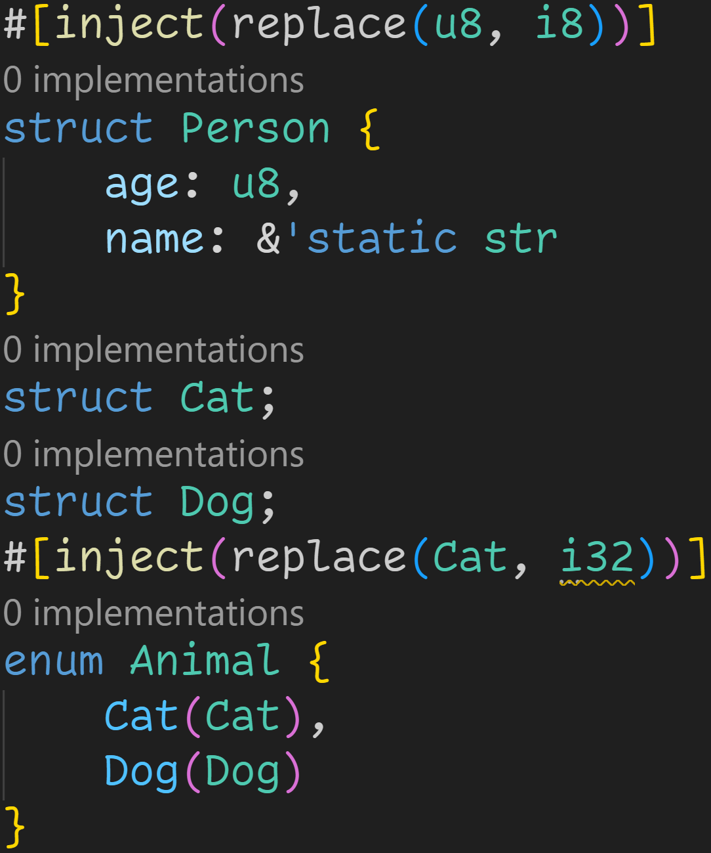
syn + quote
The attribute will also work on structs and enums

Slide 101
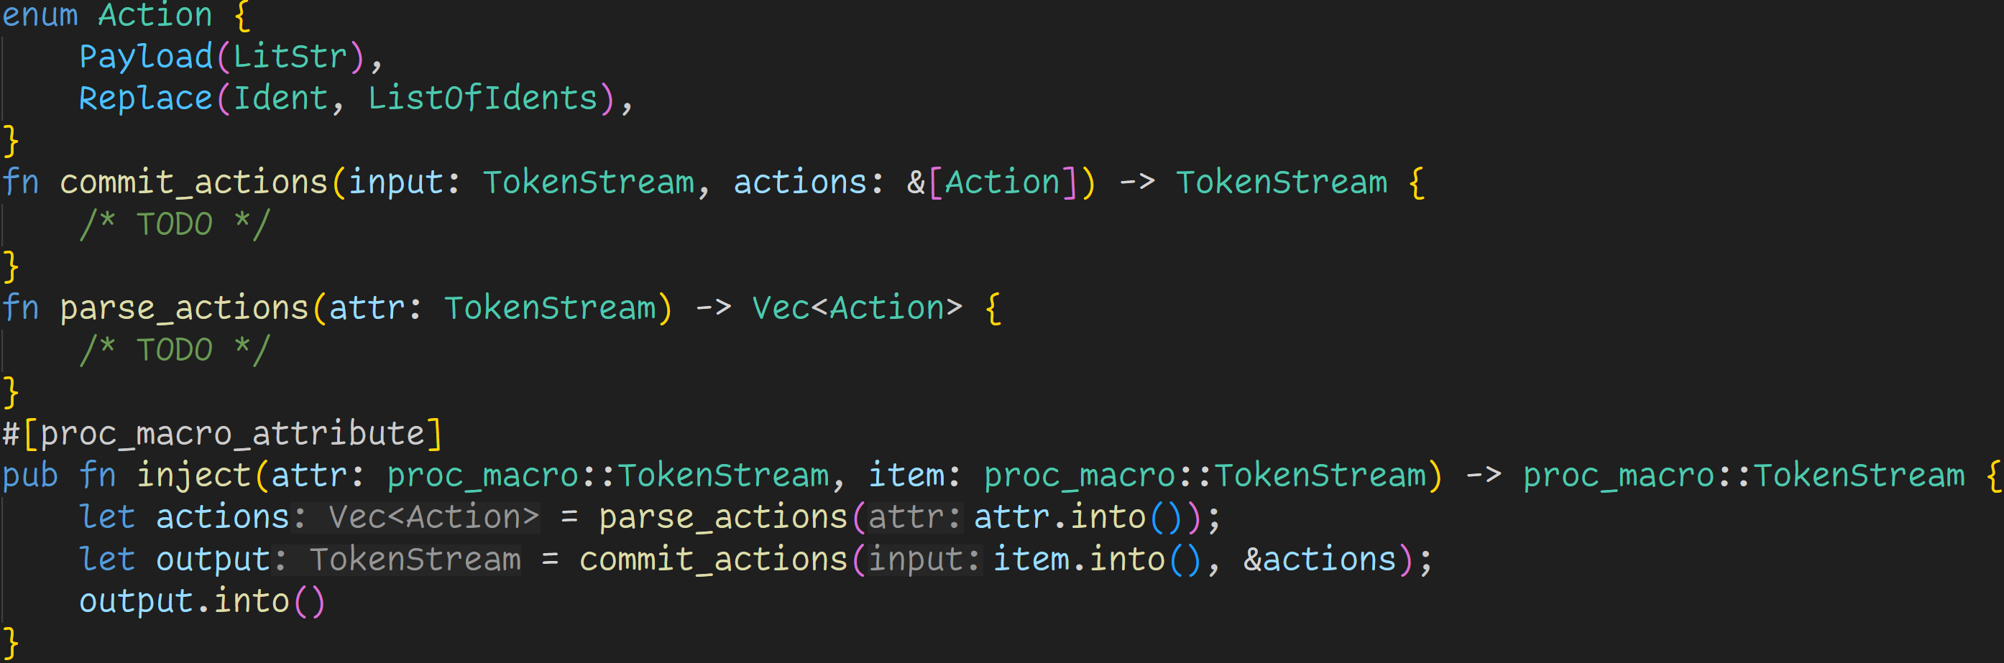
syn + quote

Slide 102
syn + quote
Our macro will run in two stages:
→ Collect all actions we provided → Perform those actions on the given input

Slide 103
syn + quote
We‘re doing it right from the start:
→ No strings, instead we‘re using proper AST nodes → We‘re using an Enum so we can easily extend the code later

Slide 104
syn + quote
Note: Those TokenStreams are from proc_macro2

Slide 105
syn + quote
Note: Those TokenStreams are from proc_macro2
We need to do some conversions because the compiler expects proc_macro

Slide 106
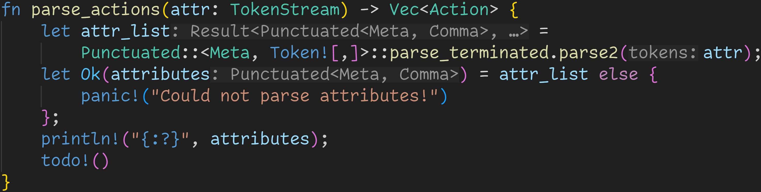
syn + quote

Slide 107
syn + quote
This time we can‘t use parse_macro_input!(), because we‘re not returning a TokenStream

Slide 108
syn + quote
syn again allows us to easily parse whatever we need

Slide 109
syn + quote
syn again allows us to easily parse whatever we need
Punctuated → A list of AST nodes, with separators in between

Slide 110
syn + quote
syn again allows us to easily parse whatever we need
Punctuated → A list of AST nodes, with separators in between Meta → One of Path, List, NameValue

Slide 111
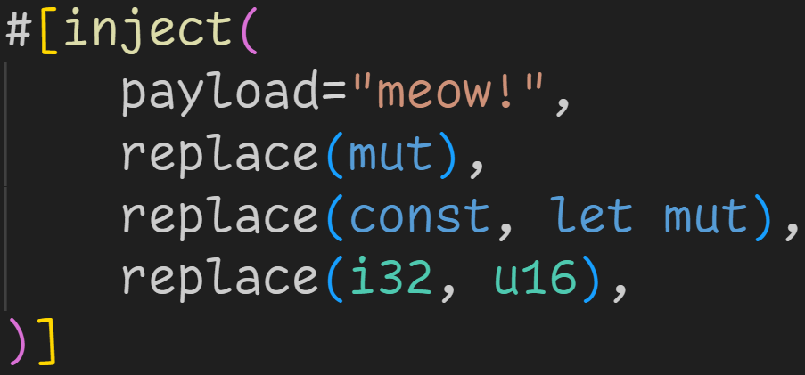
syn + quote
syn again allows us to easily parse whatever we need
Punctuated → A list of AST nodes, with separators in between Meta → One of Path, List, NameValue

Slide 112
syn + quote
syn again allows us to easily parse whatever we need
Punctuated → A list of AST nodes, with separators in between Meta → One of Path, List, NameValue
List

Slide 113
syn + quote
syn again allows us to easily parse whatever we need
Punctuated → A list of AST nodes, with separators in between Meta → One of Path, List, NameValue
NameValue

Slide 114
syn + quote
syn again allows us to easily parse whatever we need
Punctuated → A list of AST nodes, with separators in between Meta → One of Path, List, NameValue Token![,] → The nodes are comma-separated

Slide 115
syn + quote
syn again allows us to easily parse whatever we need
Punctuated → A list of AST nodes, with separators in between Meta → One of Path, List, NameValue Token![,] → The nodes are comma-separated
→ consume the whole TokenStream

Slide 116
syn + quote
syn again allows us to easily parse whatever we need
Punctuated → A list of AST nodes, with separators in between Meta → One of Path, List, NameValue Token![,] → The nodes are comma-separated
→ consume the whole TokenStream → parse2 works on proc_macro2::TokenStream → Input to parse

Slide 117
syn + quote
We now have a parsed data structure which we can work with

Slide 118
syn + quote
We now have a parsed data structure which we can work with
Well, after checking if it didn‘t fail :^)

Slide 119
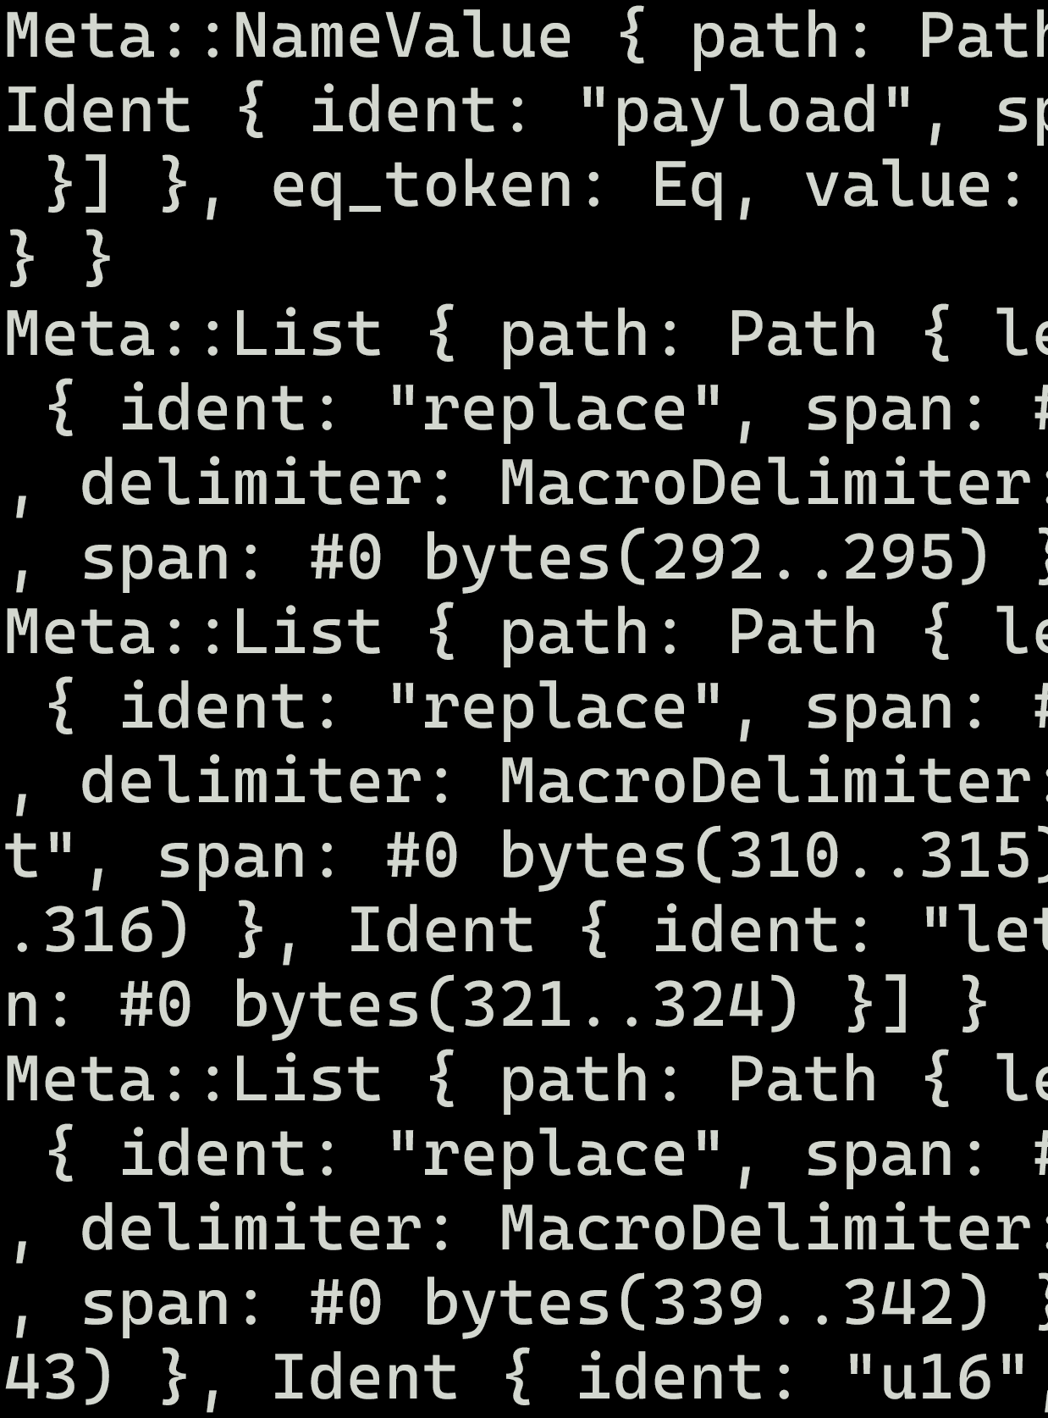
syn + quote

Slide 120
syn + quote
We can now easily go over all attributes, and collect them.

Slide 121
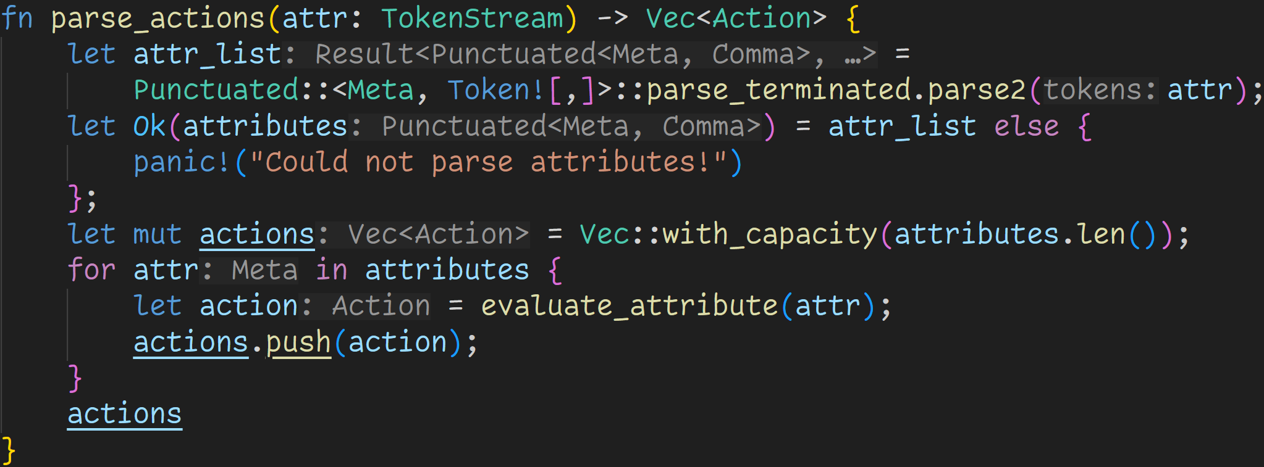
syn + quote

Slide 122
syn + quote
For every attribute, turn it into an action and push it to the list

Slide 123
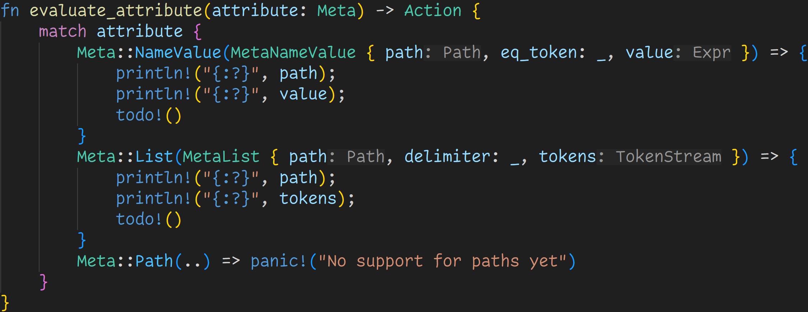
syn + quote

Slide 124
syn + quote
Thanks to syn we now work with proper data structures → Getting what we want is now a simple thing of working with those structures

Slide 125
syn + quote
Meta is an enum and comes with three variants, two of which we‘ll need

Slide 126
syn + quote
Thanks to Rust‘s pattern matching, we can easily grab everything we need

Slide 127
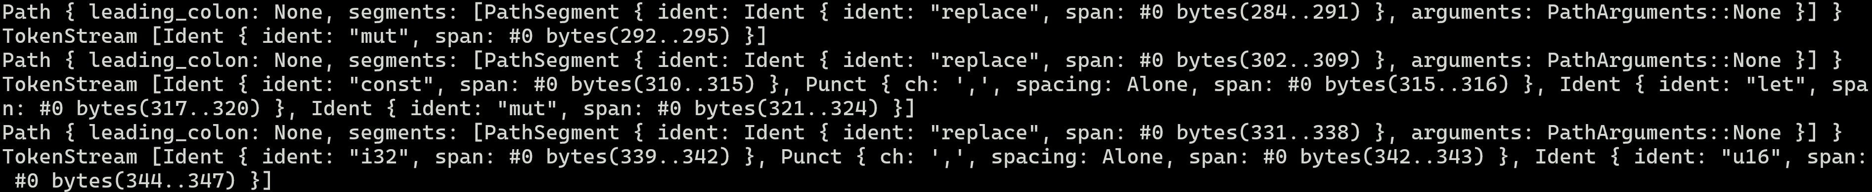
syn + quote

Slide 128
syn + quote
What we‘re after is only one more step away and is part of the Path

Slide 129
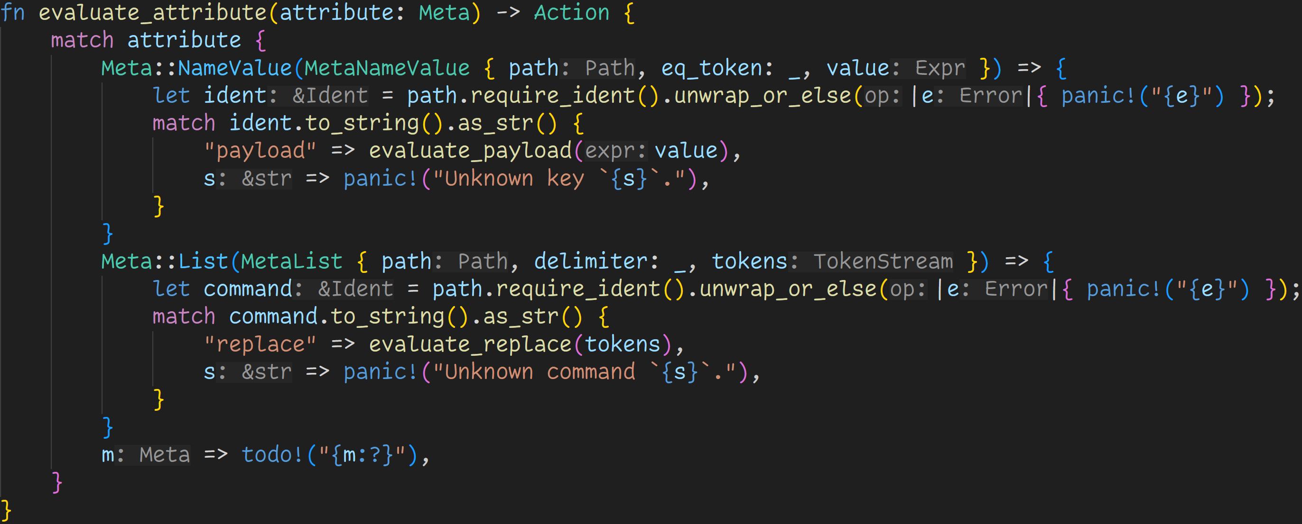
syn + quote

Slide 130
syn + quote
Paths are sequences of identifiers, like traits::macros::TypeInfo or payload
require_ident() causes an error if the path is not a single identifier

Slide 131
syn + quote
We‘re now at a point where we can work with the identifiers!

Slide 132
syn + quote
We‘re now at a point where we can work with the identifiers!
For now only payload and replace, but we can always add more later :^)

Slide 133
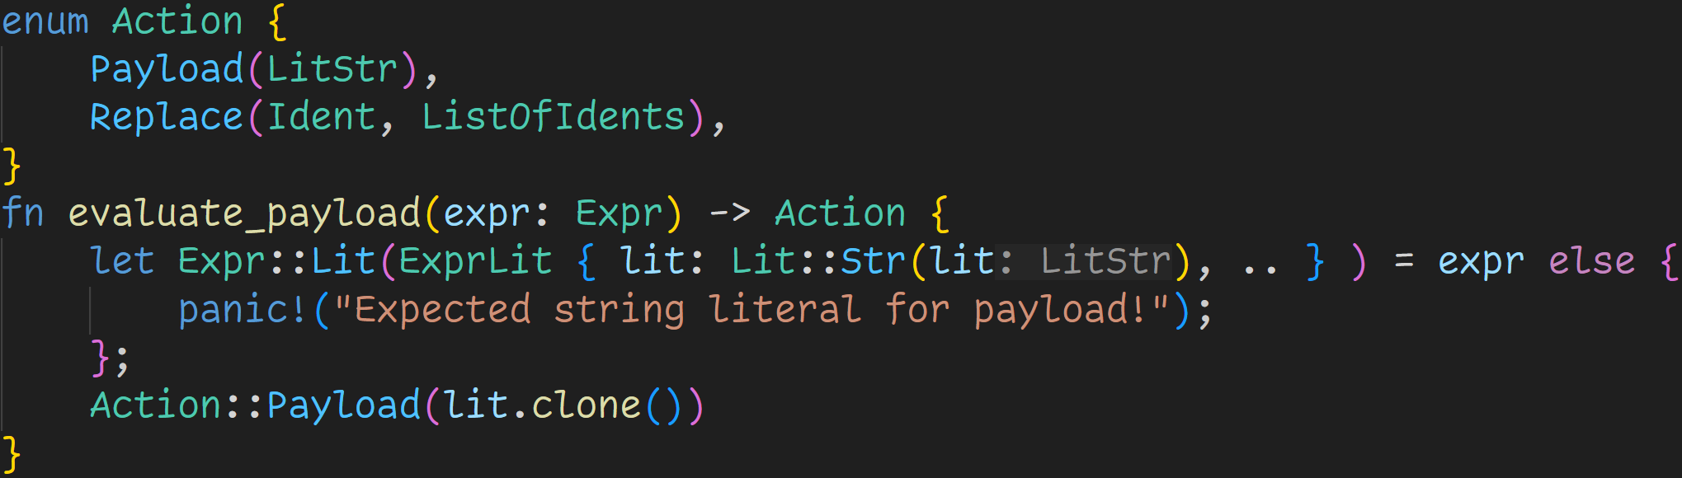
syn + quote

Slide 134
syn + quote
The payload is pretty simple → All we need is a string literal, which we can easily check thanks to pattern matching and syn

Slide 135
syn + quote
We‘re generating our first actions!

Slide 136
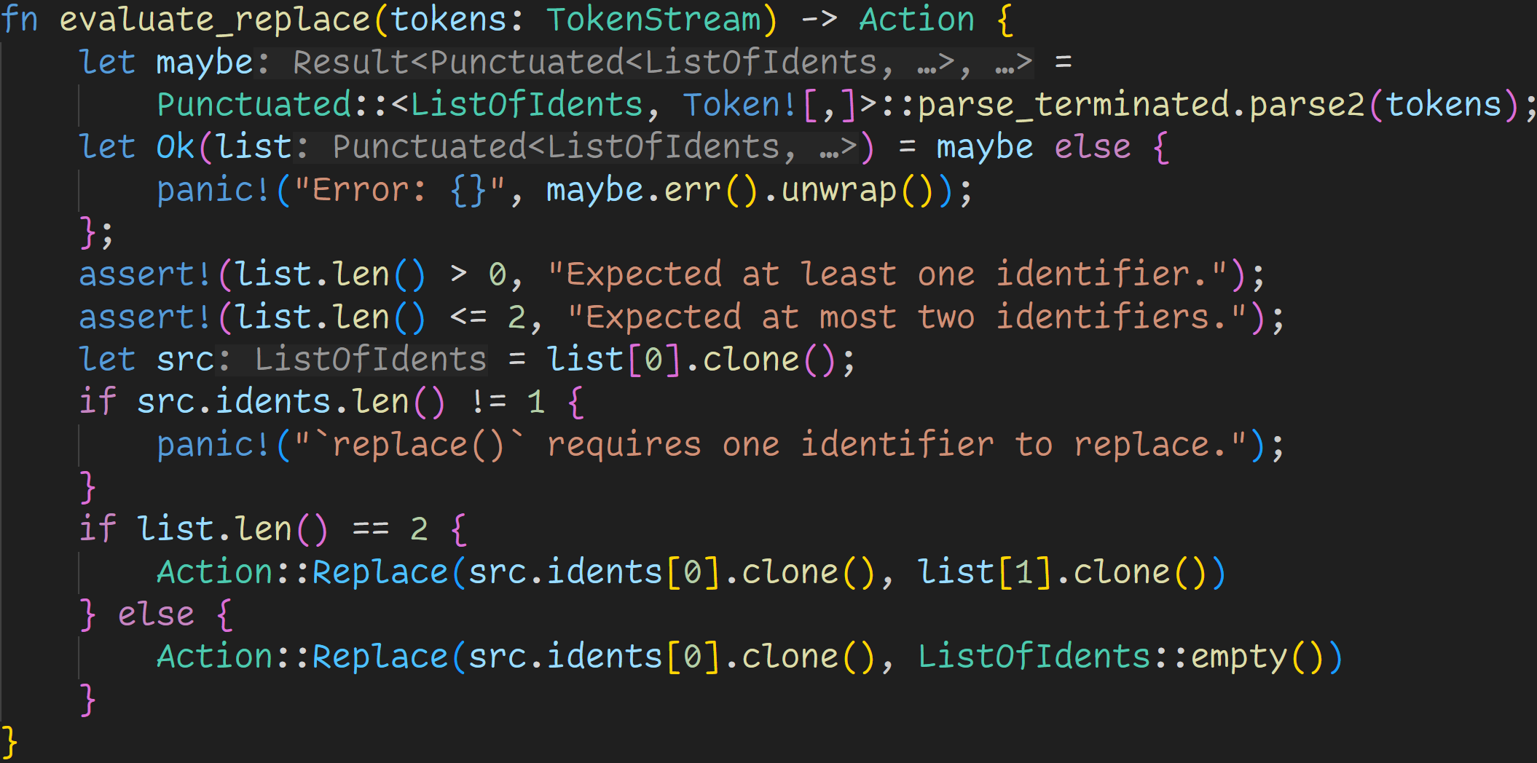
syn + quote
replace is a bit more complicated because of some edge cases

Slide 137
syn + quote
Here we‘re actually calling to our own Parser! ListOfIdents is a struct declared by us, not by syn.

Slide 138
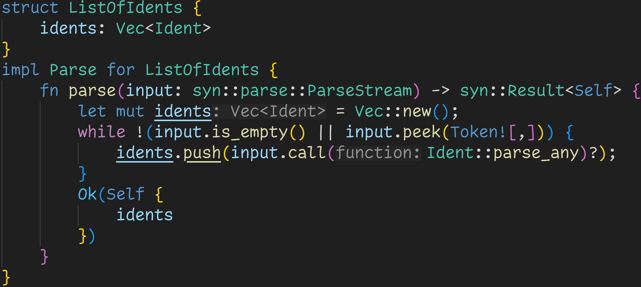
syn + quote

Slide 139
syn + quote
This struct is needed for a simple reason
→ syn does not accept keywords when parsing identifiers → let and mut are normal identifiers, but they would be rejected!

Slide 140
syn + quote
syn allows us to implement custom parsers

Slide 141
syn + quote
Our parser is pretty simple: It keeps collecting identifiers until it sees a comma or reaches the end

Slide 142
syn + quote
This way, we‘re able to call other methods of the parser → Ident::parse_any does accept keywords

Slide 143
syn + quote
At this point, list is a parsed comma-separated sequence of list of identifiers

Slide 144
syn + quote
Checking if the provided input is in the correct format

Slide 145
syn + quote
Generate an action!
Note: In the else-branch we technically delete the identifier

Slide 146
syn + quote

Slide 147
syn + quote

Slide 148
syn + quote

Slide 149
syn + quote
We don‘t replace mut with anything
→ We delete all occurences of mut (except the ones we inserted)

Slide 150
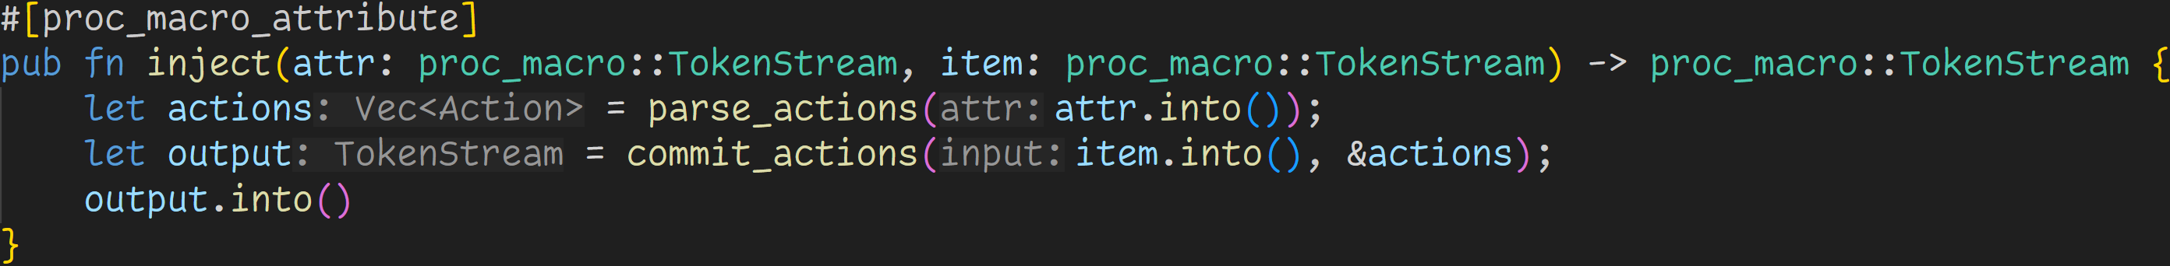
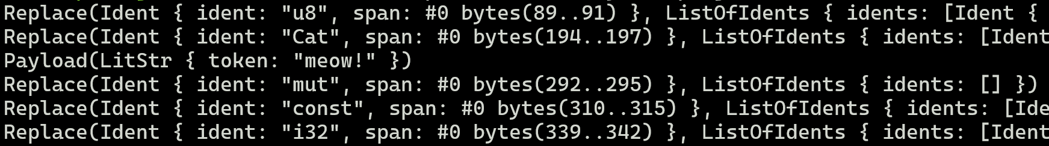
syn + quote
We‘re done parsing the attributes!
After this step, our Vector looks like this:

Slide 151
syn + quote
We can now focus on applying those rules to the input

Slide 152
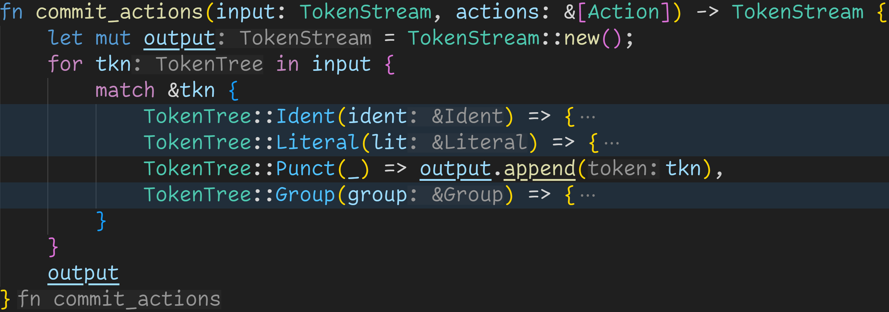
syn + quote

Slide 153
syn + quote
Idea: We‘ll slowly build up a TokenStream ourselves.
As we‘re only taking the input and slightly modify the tokens, we don‘t care whether it‘s a function or a struct, we don‘t need to parse anything.
Similarly, quote! is also not needed here.

Slide 154
syn + quote
Easy case: We never replace any Puncts, as they are only simple characters such as & % =

Slide 155
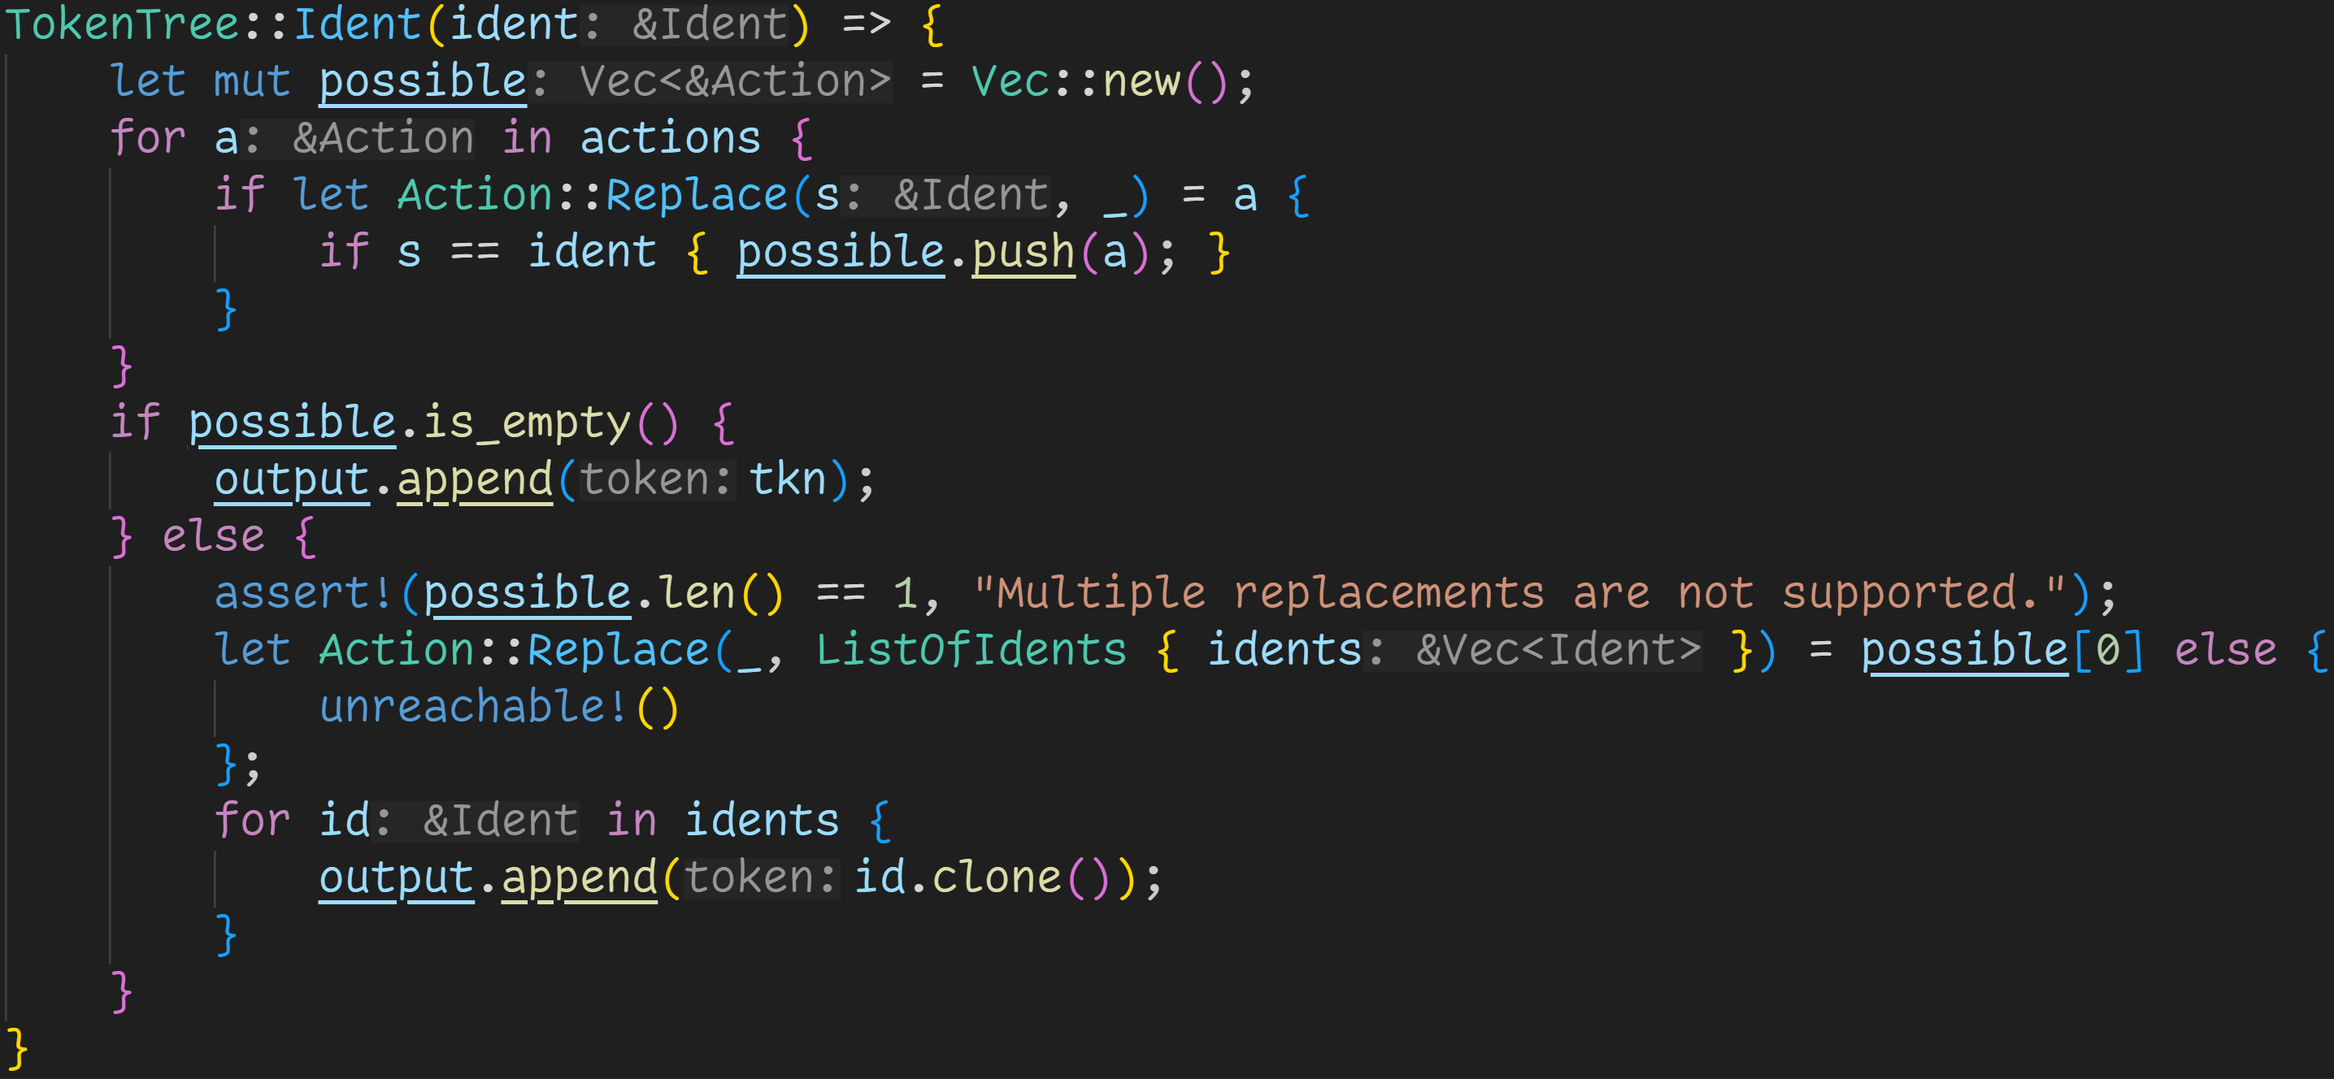
syn + quote
Identifiers are special, they can be replaced

Slide 156
syn + quote
Find possible replacements for our identifier

Slide 157
syn + quote
No replacement? Just add the token to the output

Slide 158
syn + quote
Otherwise, replace with the given identifiers

Slide 159
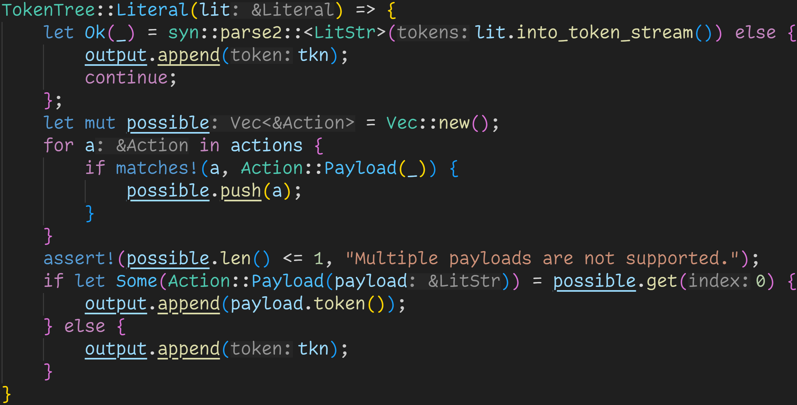
syn + quote
Literals are special, they can be replaced too

Slide 160
syn + quote
But not all literals! We only replace string literals.

Slide 161
syn + quote
Find a payload

Slide 162
syn + quote
No payload found? Just add the literal back to the output

Slide 163
syn + quote
Otherwise, insert the given string!

Slide 164
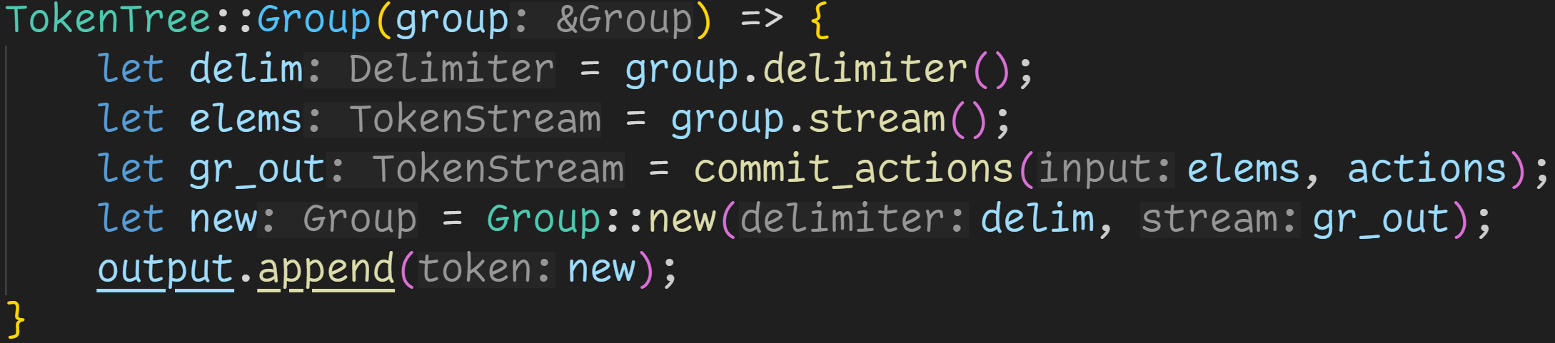
syn + quote
Groups require recursion → We want to replace everything

Slide 165
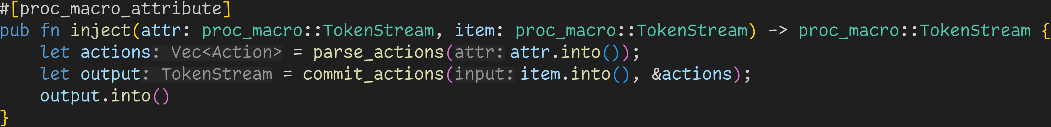
syn + quote
And we‘re done! We can now test this macro!

Slide 166
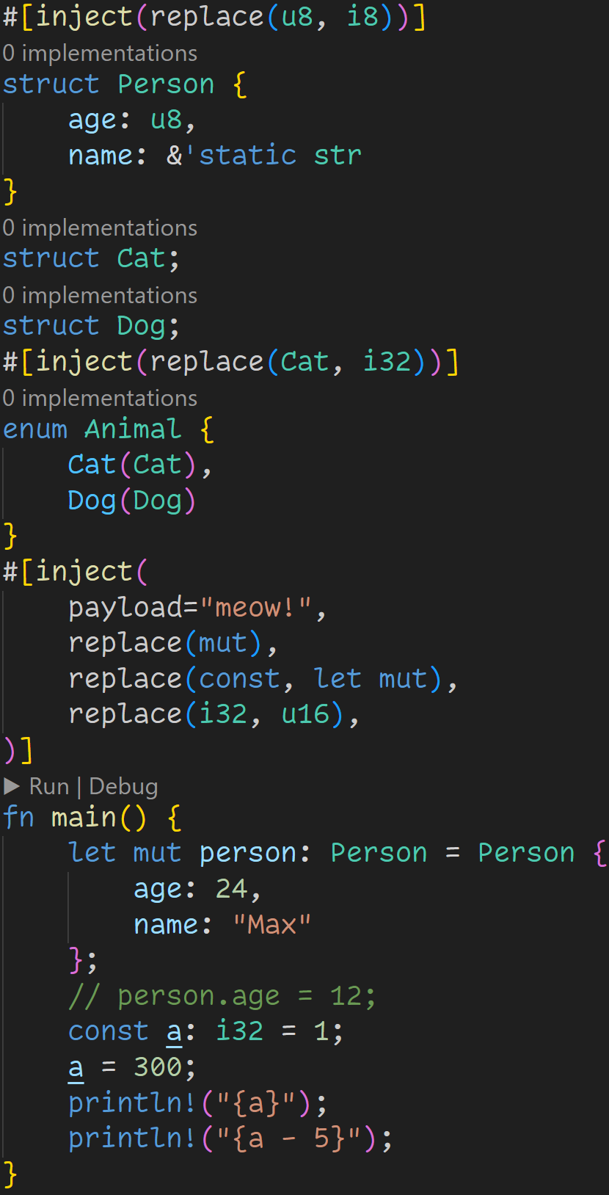

Slide 167
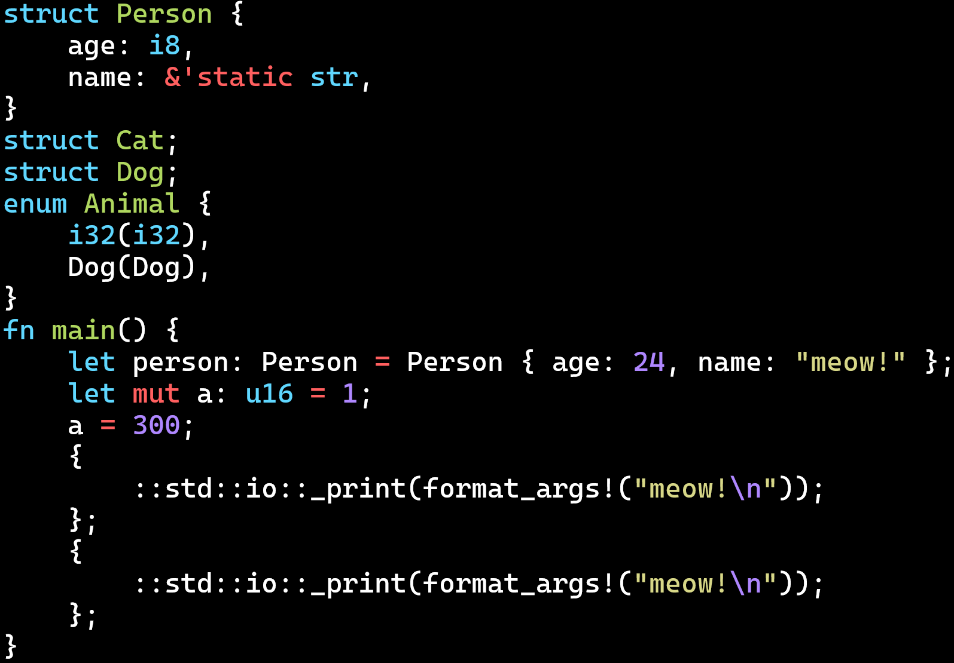
cargo expand

Slide 168
cargo expand

Slide 169
cargo expand

Slide 170
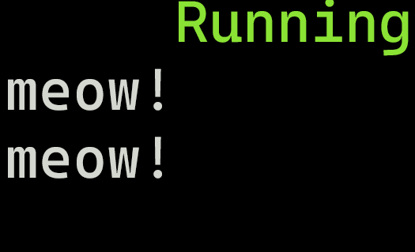
cargo run

Slide 171
Next time
Functional Programming

